Slide 1


WEATHER PREDICTION USING CLOUD IMAGES
AHAMMEDUNNY NAVAS PROJECT GUIDE:BELMA JOSEPH
CLASS: S7LA
ROLL NO:04

Slide 2
CONTENTS
1
Abstract
2
Introduction
3
Objective
4
Existing System
5
Proposed System
6
Methodology
7
Conclusion
1

Slide 3
ABSTRACT
Weather Forecasting is used to predict the conditions of the atmosphere in a given location.
It predicts how the future weather is going to be and we can plan accordingly.
Farmers will most benefit from using this technology.
Can predict the weather by analyzing the status of the cloud using Digital Image processing techniques.
2

Slide 4
INTRODUCTION
Many factors like temperature, rainfall, pressure, humidity, sunshine, wind, and cloudiness are considered for predicting the weather. It is also possible to identify the different types of clouds associated with different patterns of weather. These patterns of weather help in predicting the weather forecast.
3

Slide 5
OBJECTIVE
Weather forecasting improves transportation safety
Weather Forecasting benefits tourism
Weather forecasting is beneficial to farmers
Irrigation method is improved with the help of weather forecasting.
4

Slide 6
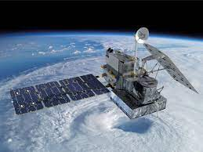
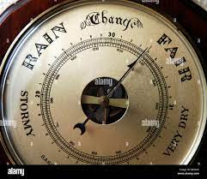

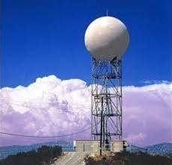
EXISTING SYSTEM
In the past, people used barometric pressure, current weather conditions, and sky conditions to predict.
Satellite images and remote sensing techniques.
The accuracy gets reduced with an increase in time.
The chaotic nature of the atmosphere as it keeps on changing
6

Slide 7
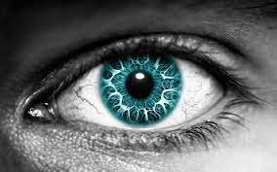
The Solution Is!
Digital Image Processing
7

Slide 8
What is DIP?
The input of that system is a digital image and the system process that image using efficient algorithms.
Digital Image Processing is used to manipulate the images using algorithms.
Image processing is essential in many fields, from photography to satellite photographs.
Digital image processing requires computers to convert images into digital form using the digital conversion method and then process them.
8

Slide 9
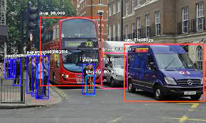
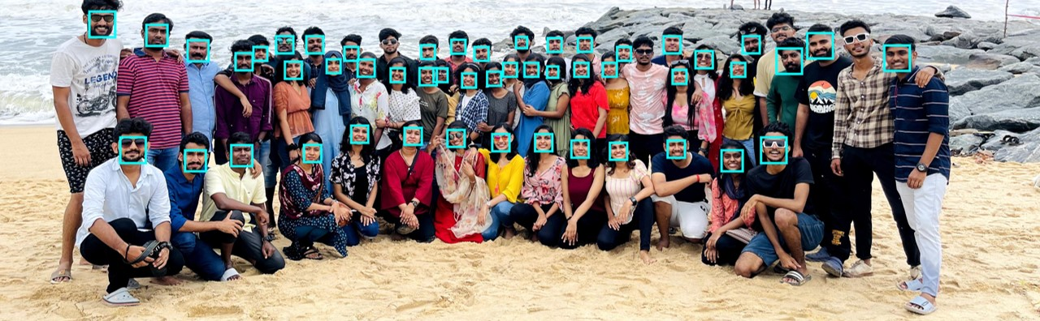
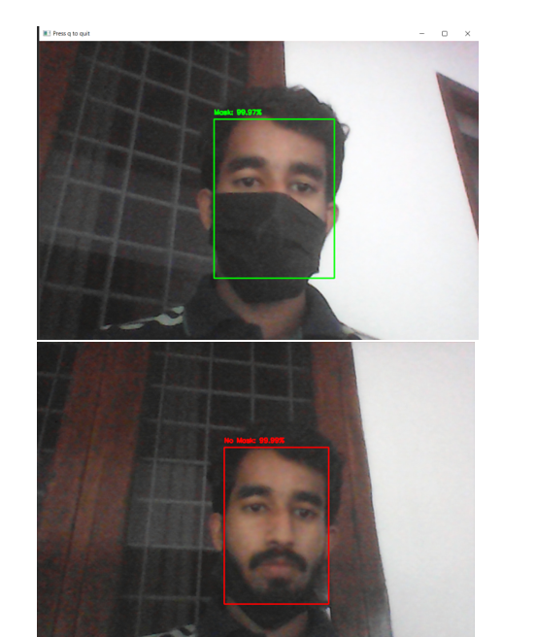
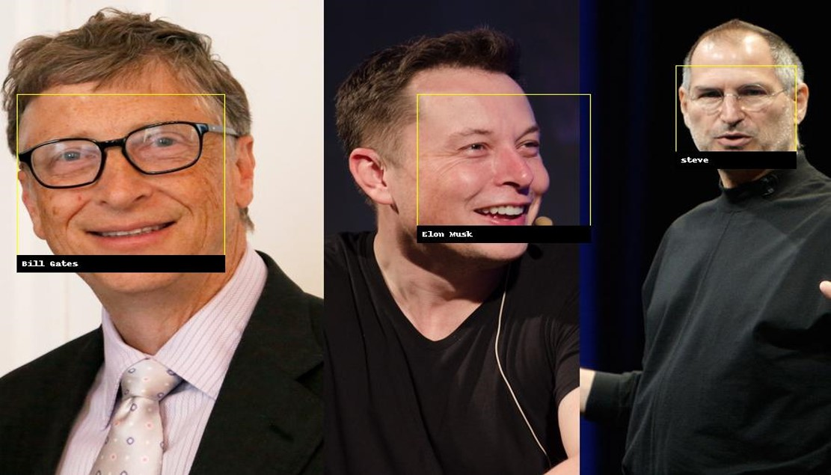
Techniques In DIP?
9

Slide 10
PROPOSED SYSTEM
Weather forecasting can also be done by using satellite images but acquiring the satellite images is more difficult and would even cost high. Even predicting using satellite images needs more technology. So, we are using digital image processing techniques which process the images of the sky like normalization, cloud masking algorithm, and k-mean algorithm.
10

Slide 11
METHODOLOGY
Image Data Collection
Normalization of image
Cloud Masking Algorithm
K-means Clustering Algorithm
11

Slide 12
Image Data Collection
Needed system for collecting sky images and meteorological data consists of two main parts (all-sky image recording, and weather sensor array).
For obtaining all-sky images, it is possible to use a fisheye camera. Such a camera has a lens that provides a 360° panorama view and a 180° vertical view.
The camera is connected to a server through an Ethernet with an option of wireless communication. Also, it is set to acquire images in the form of video sequences continuously throughout the day
The captured video will be compressed for acquiring less storage and this data will be used for further processing.
12

Slide 13
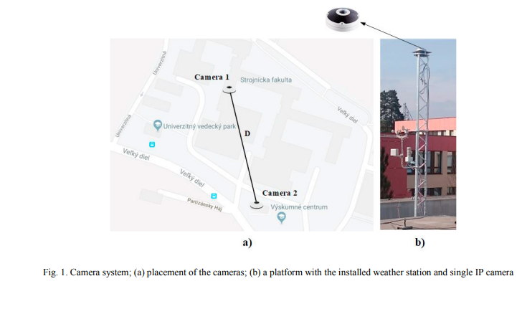
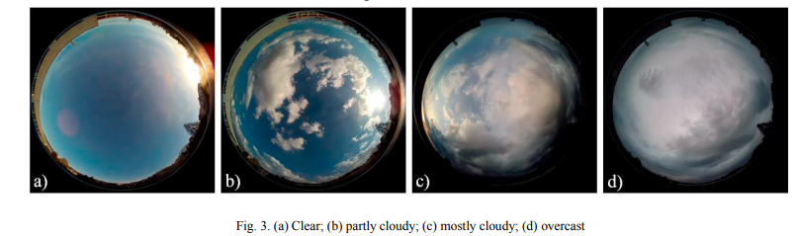
Image Data Collection
13

Slide 14
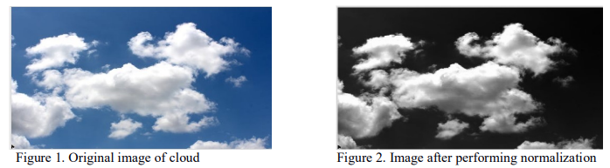
Normalization of image
Image normalization is a typical process in image processing that changes the range of pixel intensity values.
Image normalization ensures optimal comparisons across data acquisition methods and texture instances.
To remove any non-uniformities present in the imaging system, dark field image subtraction, and bright field image normalization were performed
Normalization implies making all the images have the same spatial relationship to what they demonstrate
14

Slide 15
Cloud Masking Algorithm
Cloud masking in remote sensing prepares imagery for processing and improves product generation.
Clouds (and, correspondingly, their shadows) differ in shape, size, and altitude that depend on the geographic position and climatic peculiarities of the studied region.
To extract the feature of the cloud part by again finding the mean value of the cloud area which will be used a feature in the next process.
This process is done for all the images in the dataset so that we get features of all images which will be used to cluster the images into groups.
15

Slide 16
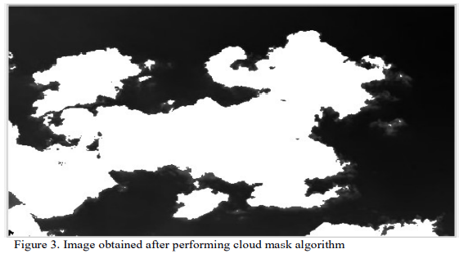
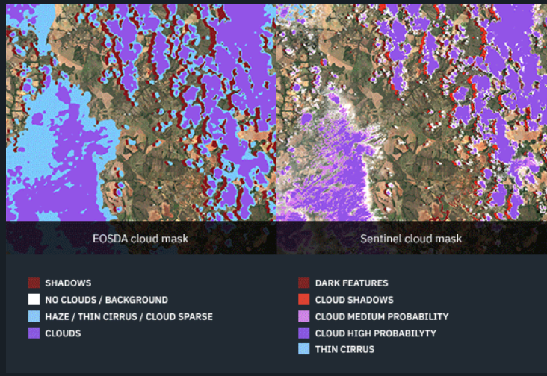
Cloud Masking Algorithm
16

Slide 17
K-means Clustering Algorithm
We considered clustering because for classification there would be less no of classes. But we considered ten types and hence we considered clustering rather than classification. Here we considered the clusters of the clouds as we would divide the image based on the cloud mean point.
Both Classification and Clustering are used for the categorization of objects into one or more classes based on their features. They appear to be a similar process as the basic difference is minute. In the case of Classification, there are predefined labels assigned to each input instance according to their properties whereas in clustering those labels are missing.
17

Slide 18
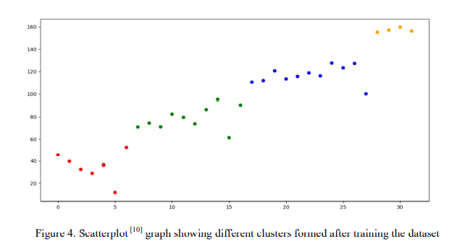
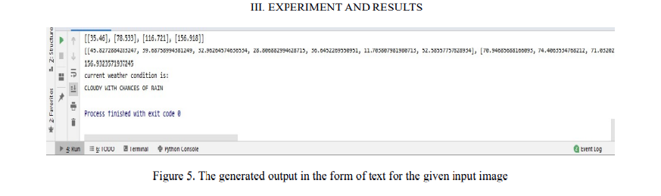
Algorithm System Output
19

Slide 19
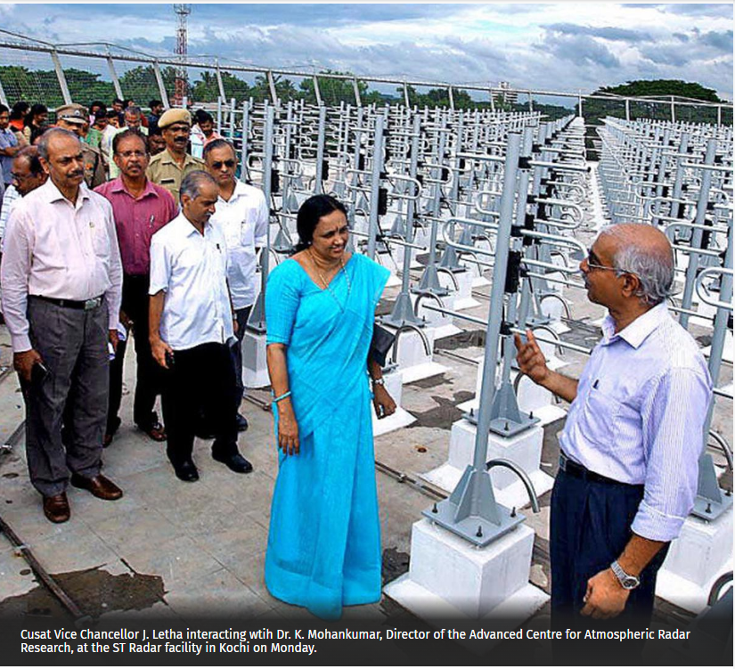
Weather Prediction In Kochi
Working on the data obtained by the wind profiles in the atmospheric region.
690 antennae arranged in a rectangular grid.
Working on 205Mhz frequency range.
Each antenna consists of a transmitter and receiver module and all these are connected to the processor for the prediction of weather.
Cochin University of Science and Technology launched its initiative utilizing the data generated using the facility at the site of its Rs. 20 crore Stratosphere Troposphere (ST) Radar.
20

Slide 20
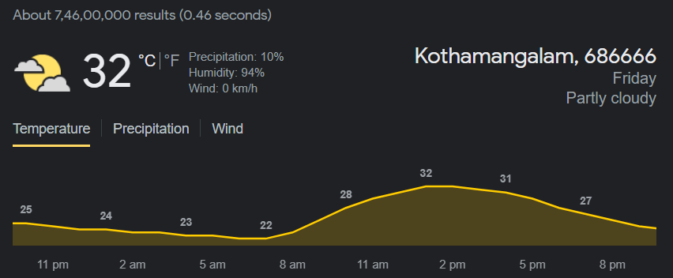
GOOGLE WEATHER PREDICTION
Using radar images, Google treats this as a computer vision problem. They use a “data-driven physics-free approach,” which means they are not using atmospheric conditions and physics to predict the weather.
Instead, they treat weather prediction as an image-to-image translation problem. One where image analysis of radar images and the use of convolutional neural networks (CNNs) can be utilized to predict the weather.
21

Slide 21
REFERENCES
Weather Forecasting Using Digital Image Processing, A Journal Of Composition Theory, ISSN: 0731-6755, Mrs. G. Gowri Pushpa Department of Computer Science and Engineering ANITS, Vishakhapatnam, Andhra Pradesh, India
In this paper, details of the weather for the past 2 days are considered. Those details are considered as input and performing linear regression and variation of functional regression, the output is obtained. The output is the weather for the next 10 days.
The author used methodologies like Normalization, Clustering, and Cloud mask algorithm to predict the weather more accurately
5

Slide 22
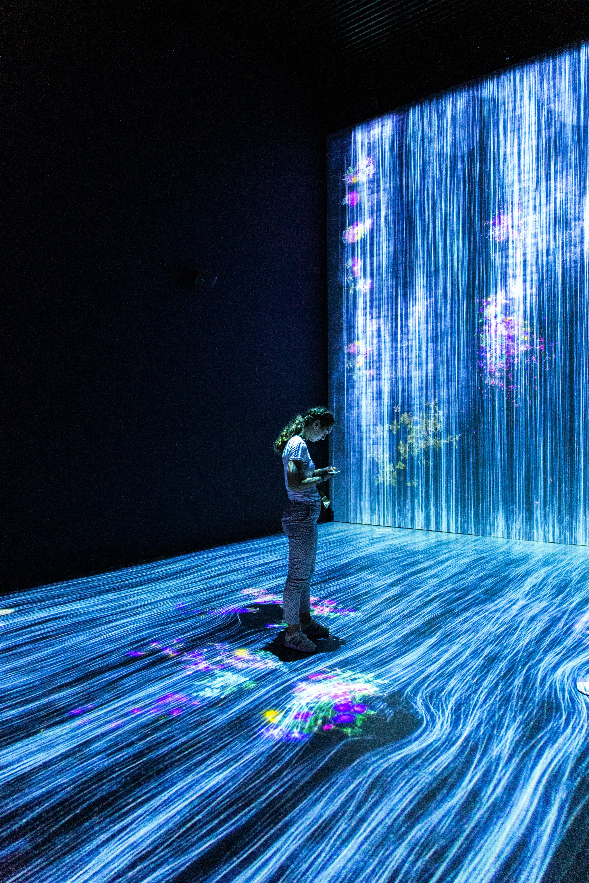
CONCLUSIONS
This can give the weather condition at any point in time for any place with the help of the current cloud image at that place.
The prediction of weather using with the help of satellite and remote sensing need high efficient technology and very expensive.
21

Slide 23


YES!
22

Slide 24
THANK YOU
23

